Slide 1

Coursera Applied Data Science Capstone Project Report: The Battle of Neighborhoods
by Anirban Neog

Slide 2
Introduction
Most professionals today care about their health and wellbeing
New gym and fitness studio memberships have seen an increasing trend in the recent years
Many people seek access to a gym near their workplace
This project attempts to leverage Foursquare location data along with other publicly available data to find the most attractive locations in the Bay Area to open a new gym
This analysis will be useful for prospective entrepreneurs in the fitness space who wish to understand the competitive landscape in the Bay Area fitness industry

Slide 3
Description of Data
A list of tech companies in the Bay Area; this list is publicly available on Github and is maintained by connor11528 (connor11528/tech-companies-and-startups)
Foursquare location around the company office locations and populate a list of current gym/fitness studios

Slide 4
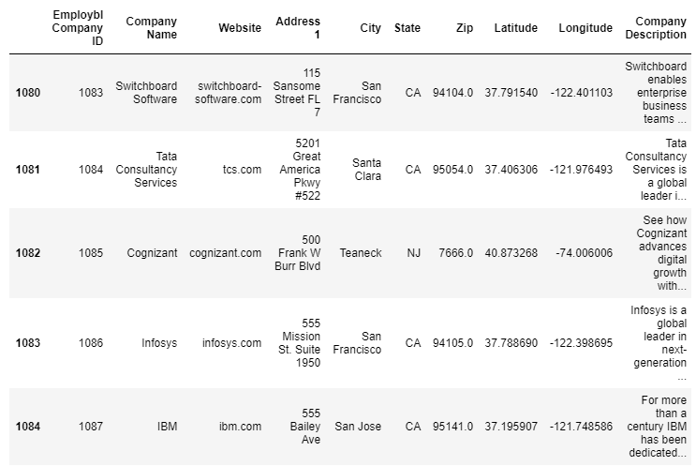
Methodology
Extract company office location data from the Github (connor11528/tech-companies-and-startups)

Slide 5
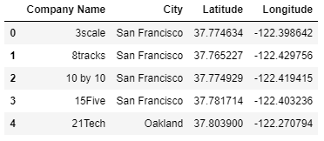
Methodology
Perform feature selection to extract necessary columns from the dataset

Slide 6
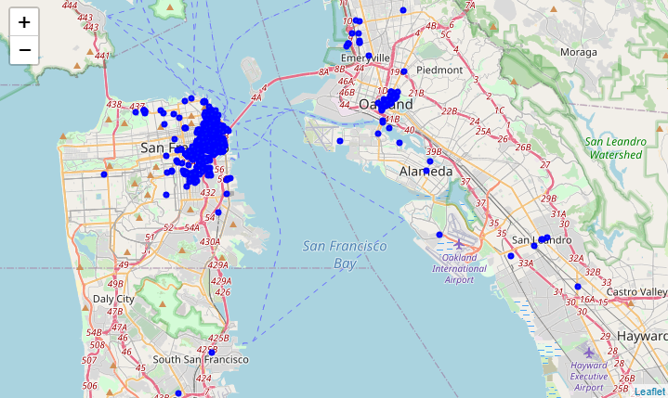
Methodology
Use folium to plot company office locations on the map of Bay Area

Slide 7
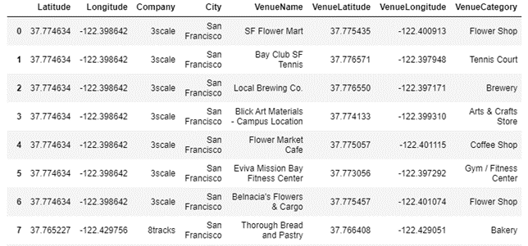
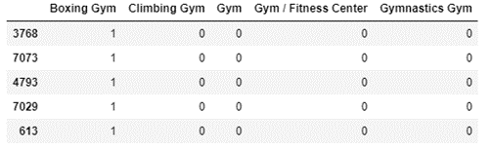
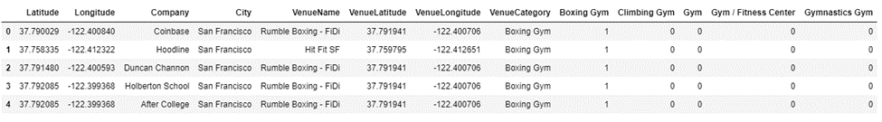
Methodology
Use Foursquare API venue explore to explore areas around office locations
Filter data for gyms and retrieve location and type
Use OneHotEncoding to create dummy variables for VenueCategory and use it as a categorical variable
Use K Means machine learning algorithm to classify the different types of gyms

Slide 8
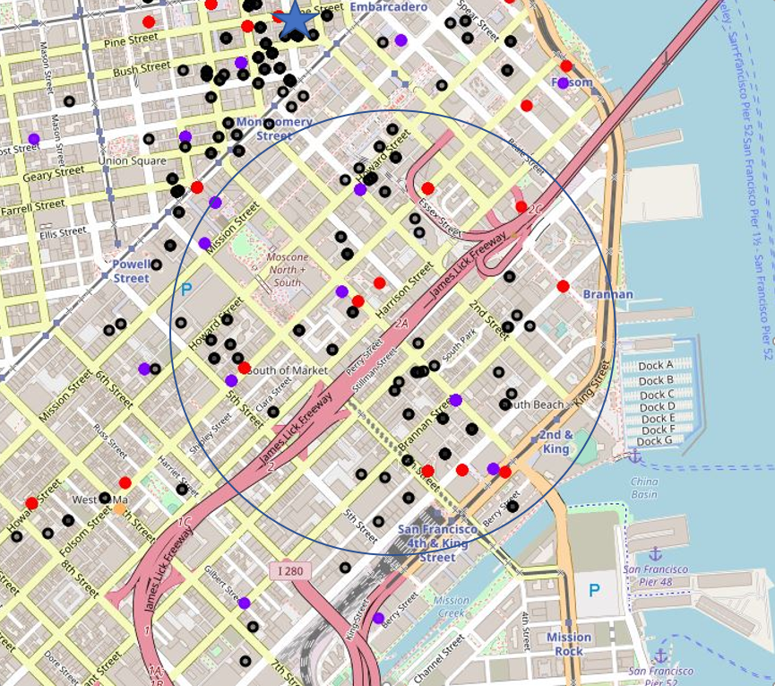
Results and Discussion
In total, in the vicinity of office locations of tech companies in the Bay Area, there are:
214 traditional gyms (red circles) ,
173 fitness centers (blue circles),
22 boxing gyms (purple circles),
2 climbing gyms (orange circles), and
3 gymnastics gyms (lime circles)
The area inside the circle has several tech companies in the area, but does not have any boxing gyms yet
It might be worthwhile to evaluate the profitability potential of setting up a boxing gym in the area

Slide 9
Conclusion
Foursquare location data can be strongly leveraged to understand viability of starting new physical businesses
In this project, we looked at potential locations in the Bay Area to start a new gym location and we found an area in San Francisco where a new boxing gym might be an interesting opportunity to evaluate

